Slide 1
Title VI & Impact Aid PROGRAM REVIEW
Respectfully submitted to the Board of Education
Amy Scott-Kronemeyer, DSA

Slide 2
Program
Overview
Impact Aid
Indian Education- Title VI
Program Reports
Grant Application for 2022 Fiscal Year

Slide 3
IMPACT AID
Federal Impact Aid is designed to assist United States local school districts that have lost property tax revenue due to the presence of tax-exempt Federal property, or that have experienced increased expenditures due to the enrollment of federally connected children, including children living on Indian lands.

Slide 4
IMPACT AID COMPONENTS
Payments for Federal Property (Section 7002)
Payments for Federal Property assist local school districts that have lost a portion of their local tax base because of Federal ownership of property. To be eligible, a school district must demonstrate that the Federal Government has acquired, since 1938, real property with an assessed valuation of at least 10 percent of all real property in the district at the time of acquisition.
Basic Support Payments (Section 7003(b))
Basic Support Payments help local school districts that educate federally connected children. These may be the children of members of the uniformed services, children who reside on Indian lands, children who reside on Federal property or in federally subsidized low-rent housing, and children whose parents work on Federal Property . In general, to be eligible for assistance a local school district must educate at least 400 such children in average daily attendance, or the federally connected children must make up at least 3 percent of the school district's total average daily attendance. Heavily Impacted Districts that enroll certain percentages of federally connected children and meet other specific statutory criteria, receive increased formula payments under Section 7003(b)(2).
Children With Disabilities Payments (Section 7003(d))
Payments for Children with Disabilities provide additional assistance to school districts that educate federally connected children who are eligible for services under the Individuals with Disabilities Act (IDEA). These payments are in addition to Basic Support Payments and IDEA funds provided on behalf of these children. A school district that receives these funds MUST use them for the increased costs of educating federally connected children with disabilities.

Slide 5
HOW DO WE USE IMPACT AID FUNDS
Sault Schools uses Impact Aid for a wide variety of expenses, including the salaries of teachers and teacher aides; purchasing textbooks, computers, and other equipment; after-school programs and remedial tutoring; advanced placement classes; and special enrichment programs.
Payments for Children with Disabilities must be used for the extra costs of educating students with disabilities.

Slide 6
PURPOSE
This program is designed to address the unique cultural, language, and educationally related academic needs of American Indian and Alaska Native students, including preschool children. The programs funded are to meet the unique cultural, language, and educational needs of Indian students and ensure that all students meet the challenging State academic standard. The program is the Department's principal vehicle for addressing the particular needs of Indian children.

Slide 7
Impact Aid
Data
Property | 2018-2019 | 2019-2020 | 2020-2021
Bay Mills Employed | 10 | 10 | 9
Bay Mills Housing Authority | 1 | 1 | 1
Bay Mills Reservation live on | 1 | 0 | 0
Bay Mills Community College | 11 | 9 | 5
Ojibwe Charter School | 11 | 0 | 1
Sault Tribe-Reside | 88 | 79 | 76
Sault Tribe- Employed | 137 | 131 | 141
Demawating | 8 | 8 | 7
JKL Bahweting | 18 | 20 | 22
US Coast Guard Live On | 18 | 20 | 19
US Coast Guard Life Off | 16 | 19 | 27
US Customs | 21 | 25 | 26
US Corps of Engineers | 22 | 34 | 35
Low Income Housing | 80 | 82 | 79
Inter-Tribal | 6 | 6 | 4
DK security | 4 | 6 | 0
Railroad | 1 | 0 | 0
Hiawatha National Forest | 1 | 1 | 1

Slide 8
THE INDIAN EDUCATION FORMULA GRANT
Provides grants to support local educational agencies in their efforts to reform elementary and secondary school programs that serve Indian students. Annually each applicant develops and submits to the Department a comprehensive plan for meeting the needs of Indian children.
Applicants must develop this plan in collaboration with a local committee comprised primarily of parents and family members of Indian children and must include
student performance goals
a description of professional development activities that the applicant will carry out
an explanation of how it will assess students’ progress toward meeting its goals
provide the results to the parent committee, Indian community and tribes whose children are served by the LEA.

Slide 9
ALLOWABLE PROJECTS
Grant funds supplement the regular school program by meeting the culturally related academic needs of Indian children.
Projects help Indian children sharpen their academic skills, assist students in becoming proficient in the core content areas, and provide students an opportunity to participate in enrichment programs that would otherwise be unavailable.
Legislation Elementary and Secondary Education Act of 1965, as amended, Title VII, Part A, Subpart 1; 20 U.S.C. 7421-7429, 7491-7492
Regulations EDGAR

Slide 10
Program Overview:
To help American Indian and Alaska Native children achieve to the same challenging standards expected of all students by supporting access to programs that meet their unique educational and culturally related academic need.
Objective: American Indian and Alaska Native students served by LEAs receiving Indian Education Formula Grants will progress at rates similar to those for all students in achievement to standards, promotion, and graduation.
Increase the percentage of American Indian students who scored at or above basic level in reading and math on NAEP(Federal)
Increase the percentage of American Indian students who scored at or above basic level in reading and math on State Assessments (Federal, State CCR)
Increase graduation rate of American Indian students (Federal)
Decrease Chronic Absenteeism (Local in line with ESSA)

Slide 11
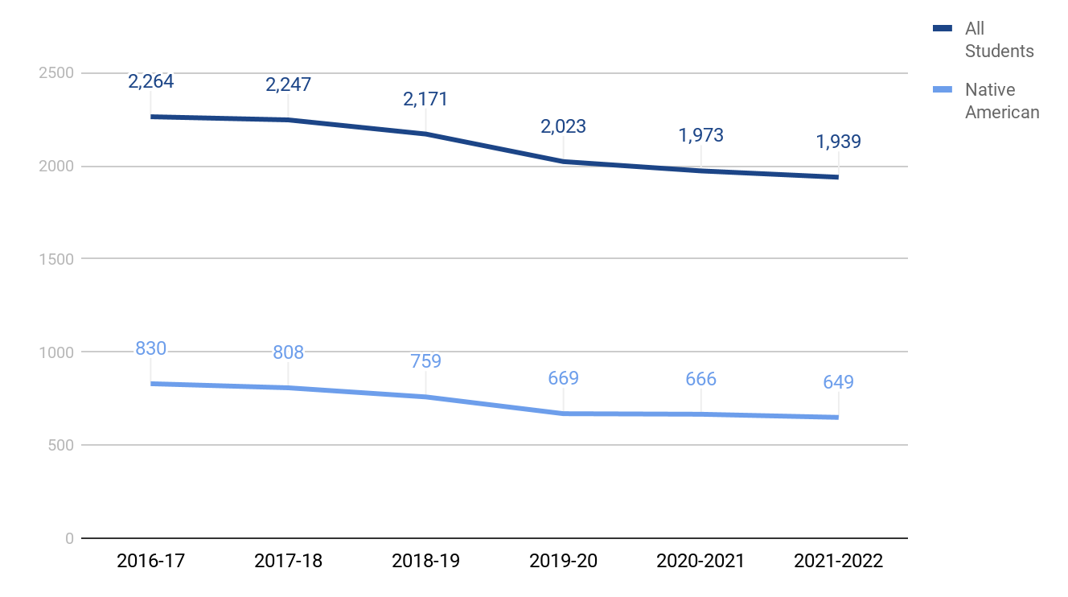
Student Enrollment in Sault Schools overall is decreasing; the amount of students identified as American Indian (506) remains very consistent.
Based on October Count of the previous year. MISCHOOLDATA.ORG

Slide 12
ALLOCATION
 | 2014 | 2015 | 2016 | 2017 | 2018 | 2019 | 2020 | 2021 | 2022
Award Amounts | $179,462 | $179,462 | $176,634 | $171,368 | 173,399 | $182, 306 | $162,817 | $162,400 | $162,400
Student Numbers with 506 Cards | 768 | 772 | 767 | 752 | 774 | 729 | 669 | 666 | *649
Notes:
250 per student can fluctuate $5000

Slide 13
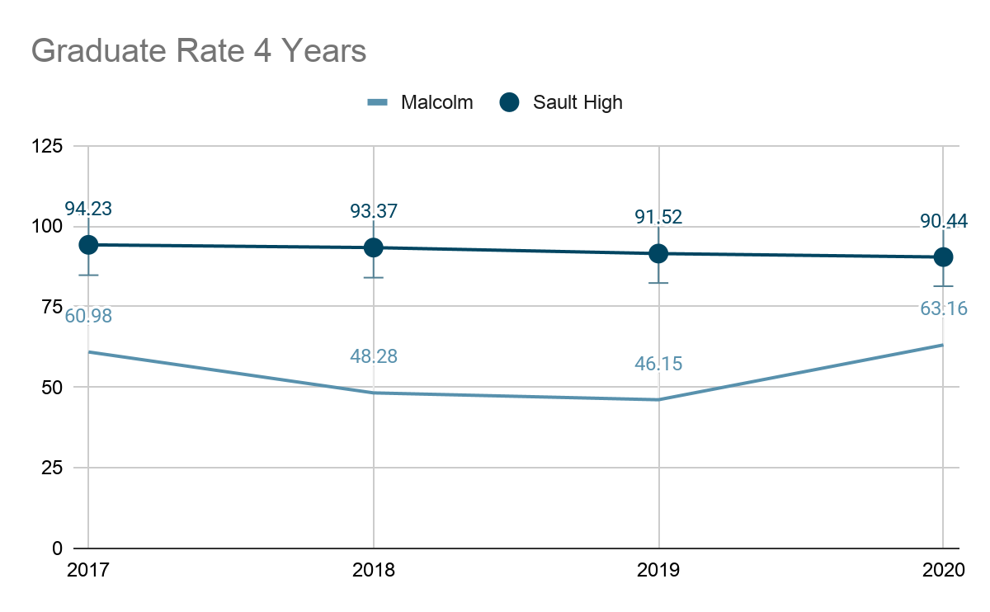
Graduation Rate
Year | State | District
2017 | 80.18 | 86.50
2018 | 80.64 | 84.13
2019 | 81.41 | 80.28
2020 | 82.07 | 81.28

Slide 14
Dropout Rate
Dropout rates of Males (15.38 %)
Dropout rate Native American Males(21.62%)
Dropout rate of White Males (10.77%)
Dropout rates of Females (10.84 %)
Dropout rate Native American Females(15.48%)
Dropout rate of White Females (7.14%)
Notes:
State 9.52
NA 11.82
NA Males 17.65
NA Females 5.68

Slide 15
PROGRAM COMMITTEE PROGRAM STAFF
Program Committee | Program Staff
Sandy Sawyer Tan-A Hoffman Lindsey Gregg Brittany Gillett Vanessa Owaski-Patzwald Heather Syrette | Erika Laitinen-Odbert Jennifer Blair Symantha Morley

Slide 16
Elementary Program
Academic Support
Provide 1:1 and small group support in all academic areas
Proctor make up standardized testing
Provide and support students with completing daily work and organization skills
Other Support
Develop a behavior plan with students and reinforcing good behavior
Assist with transportation for attendance and appointments
Social /Emotional support both individual and group
In classroom instruction for Emotional Zone regulations
Support and educate diabetic students
Address food, clothing, and hygiene insecurities for students and families
Cultural Support
Literacy push in lesson in the classrooms: 1 per marking period for each classroom
Michigan Elders program for fourth grade students
Bulletin Boards with the 7 Grandfather Teachings and famous Native Americans
Partner with the educational department at Sault Tribe to establish a educational pacing guide.

Slide 17
Elementary Program
Intervention Services
Reading Support
Native American - 39
Non Native - 75
Math Support
Native American -21
Non Native - 13
Social-Emotional Support one to one
Native American - 23
Nan Native - 32

Slide 18
SAULT MIDDLE SCHOOL
Academic Support
Communication with parents to support open communication and academic success
Check in/Check out: needs and frequency determined case-by-case
Utilize SRSS to further identify NA students supports needed
Attendance Support
Complete truancy protocol steps w/ administration. Contact/meet with students and parents as needed
Monitor attendance of students that have entered into the truancy protocol steps
Monitor attendance for Virtual Blue students
Maintain contact with county probation officers regarding attendance and students on probation
Cultural Support
Native American culture and education bulletin boards
Annual days/events creating awareness: Orange Shirt Day and Indigenous People’s Day
Native American Heritage Month:Materials/resources shared-mail/facebook/website.
Reading Month: Native American Literature
Bulletin board, read NA literature in 6 classrooms with activity, made dreamcatchers with a class, made fry bread with students.
Other Support
Provide social and emotional support for students and help them access additional resources needed
PBIS team coordinator- promote the SWPBIS with student and staff supports
Address food, clothing, and hygiene insecurities for students and families
Participate in and implement student safety and supervision plans

Slide 19
SAULT MIDDLE SCHOOL
Intervention Services
Reading Support
Native American- 19
Non-Native- 36
Math Support
Native American- 25
Non-Native-22
Social Emotional Support
Native American- 7
Non-Native- 12

Slide 20
MALCOLM HIGH SCHOOL
Academic Support-
Check in/ Check out (frequency depends on the individual student)
Review Progress Reports 3 times per marking period with students
Flex Fridays
PBIS- (Honor Roll Lunch, mid-term incentives for passing grades)
Check in with parapros often to discuss the academic status of students for targeted help
Attendance Support-
Call Parents Regularly when students experience poor attendance
PBIS- (Coffee for kids who come to school on time, perfect attendance lunch)
In School Suspension System to reduce tardiness and absenteeism throughout the day due to skipping
Tightened attendance policy which has had positive effects
Other Support-
Setting behavior goals with students and rewarding good behavior
Assisting in college and work applications to further student goals
Provide social and emotional support for students and help them access other resources they may need
Relying heavily on online communication to stay in touch with students during quarantine and remaining available to students during this difficult time

Slide 21
MALCOLM HIGH SCHOOL
School Demographics
Students- NA 45
Students-Non Native 43
African American 4
Students In CTE Classes- 1-NA
Intervention services include Academic support, mentoring, and social support
BIE Funds- Tribal Funding Support
Paraprofessional Salaries- 2 parapros for Math, Reading, and Science
PBIS- BIE funding supports Malcolm’s PBIS system
Student Resources- BIE funding used for homeless students and other necessary resources

Slide 22
SAULT HIGH SCHOOL
Goal is to focus Active Efforts on the immediate needs of our Native American Students
Academic Support:
Weekly grade checks with at risk students - go over grades and missing work, work on organizational skills.
Coordinate & collect data for Tier 2 interventions(Silent mentoring, CICO, Groups & Lunch Learning Program 9th Grade)
College & Scholarship applications to further student goals
Attendance Support:
Monitoring attendance, meet with students that are flagged, phone calls home to guardians.
Attendance/Truancy meetings organized by Administration. Meetings consist of Vice Principal, Academic Counselor, Native Advisor, student and parent.
Added Attendance measures (tardy sweeps, student & parent meetings) Noticed improvement of tardies and absences.
Other Support:
Cultural activities - Dreamcatchers & Talking Circles (peer to peer emotional support)
Provide social and emotional support for students and help them access additional resources that may assist them

Slide 23
SAULT HIGH SCHOOL
Participation in Advanced Classes and CTE Course-Work
Grade Level | Native Students in Advanced Classes (Students may be enrolled in more than 1 Advanced class) | Native Students in CTE
Grade 9 - 81 students | 30 | 0
Grade 10 - 75 students | 88 | 18
Grade 11 - 62 students | 48 | 40
Grade 12 - 51 students | 19 | 43

Slide 24
SAULT HIGH SCHOOL
Intervention Service
Silent mentoring/CICO/Groups/Social work referrals
Native American - 32
Non-Native - 67
9th Grade Lunch Learning:
Native American - 25
Non-Native - 42
SAT Prep
Native American - 18
Non-Native - 33
Notes:
154 Total Students

Slide 25
PROGRAM PLAN FOR 2021-2022
Increase Student Achievement
Increase Graduation Rate
Decrease Chronic Absenteeism
Check-in Check out
Programming Access
Encourage Rigorous Coursework
Native American Literature
Early Warning and Intervention System
Credit Recovery
Partnerships
Mentorship
Tribal Youth Council
Cultural presentations
PBIS
Early Warning
Parent Awareness
Cultural awareness
Professional learning in cultural competency
Increase Parent Involvement

Slide 26
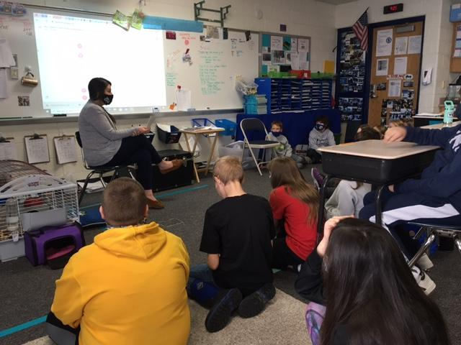
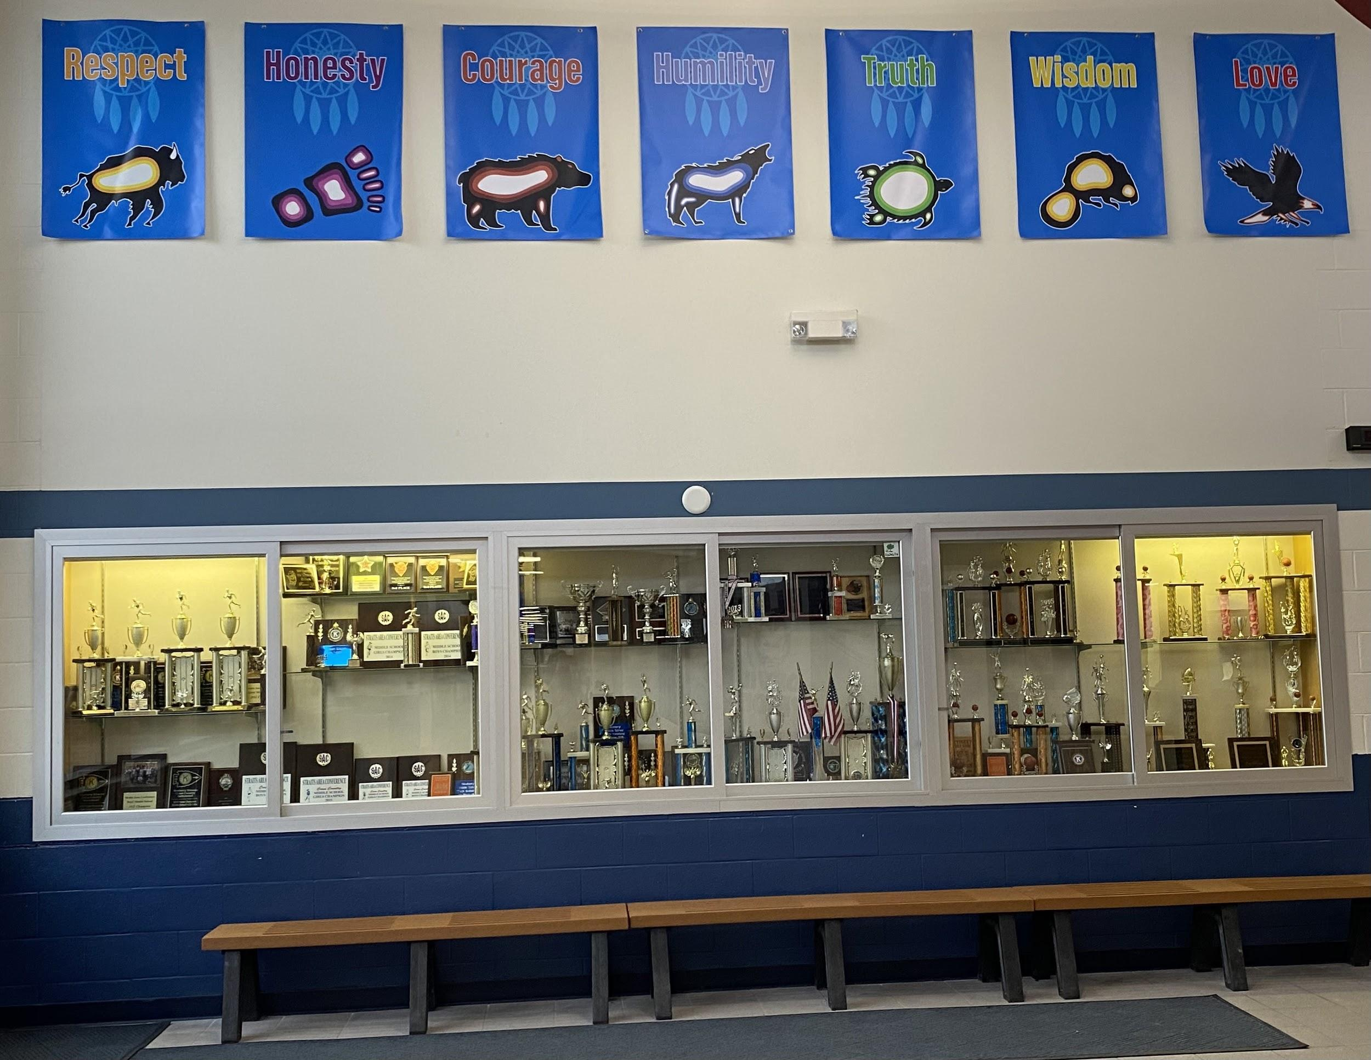
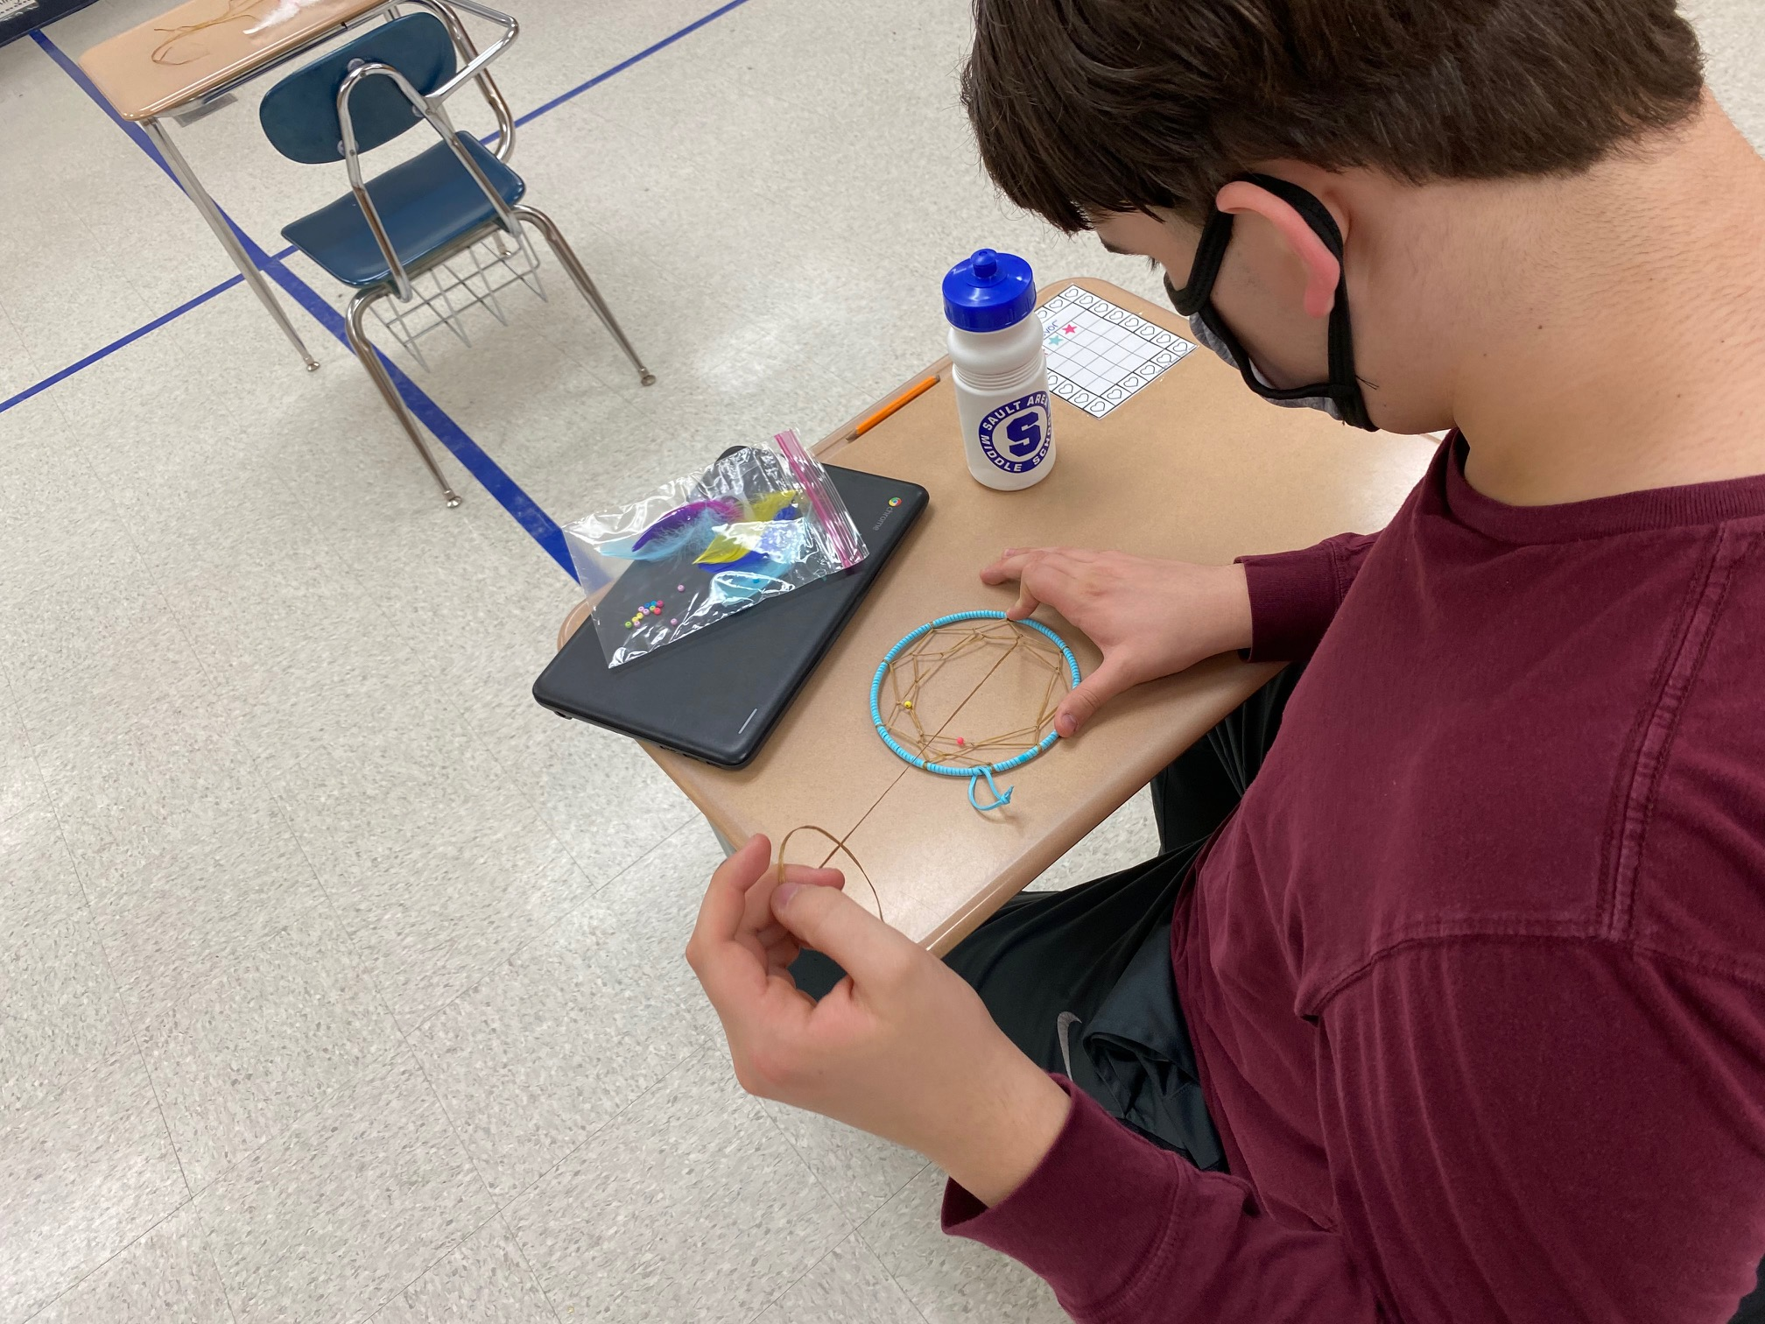
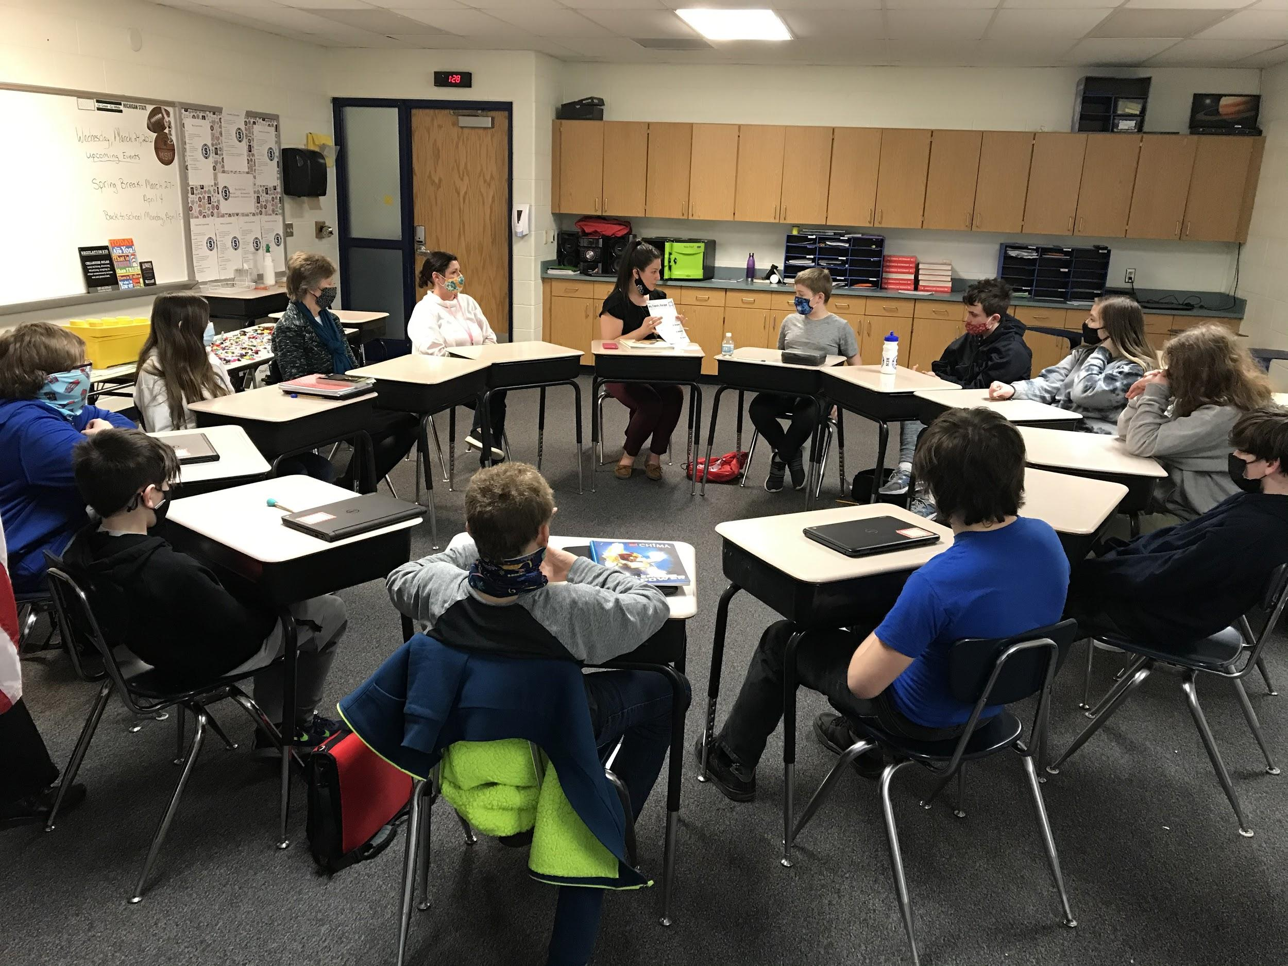
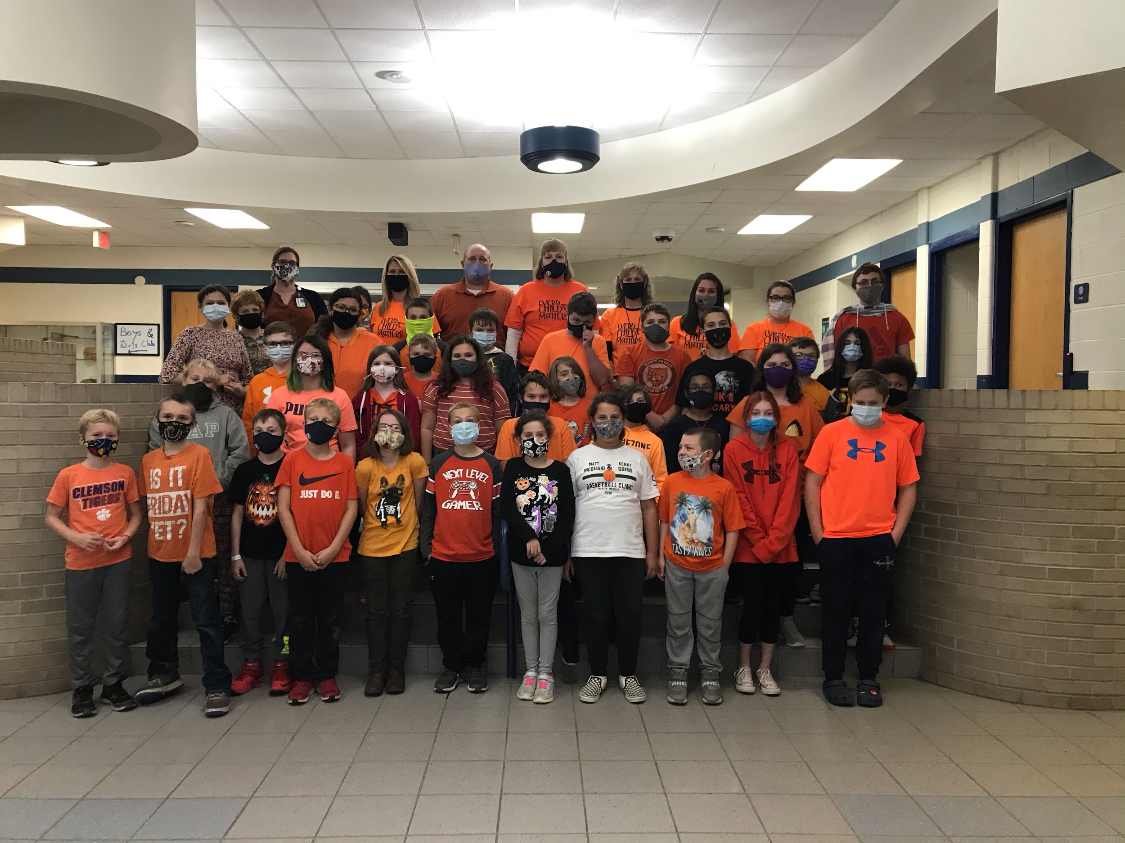
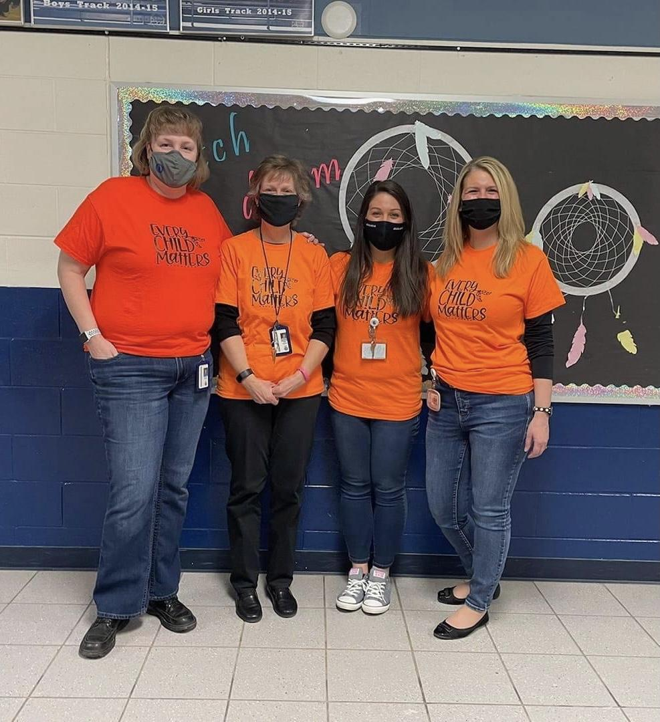
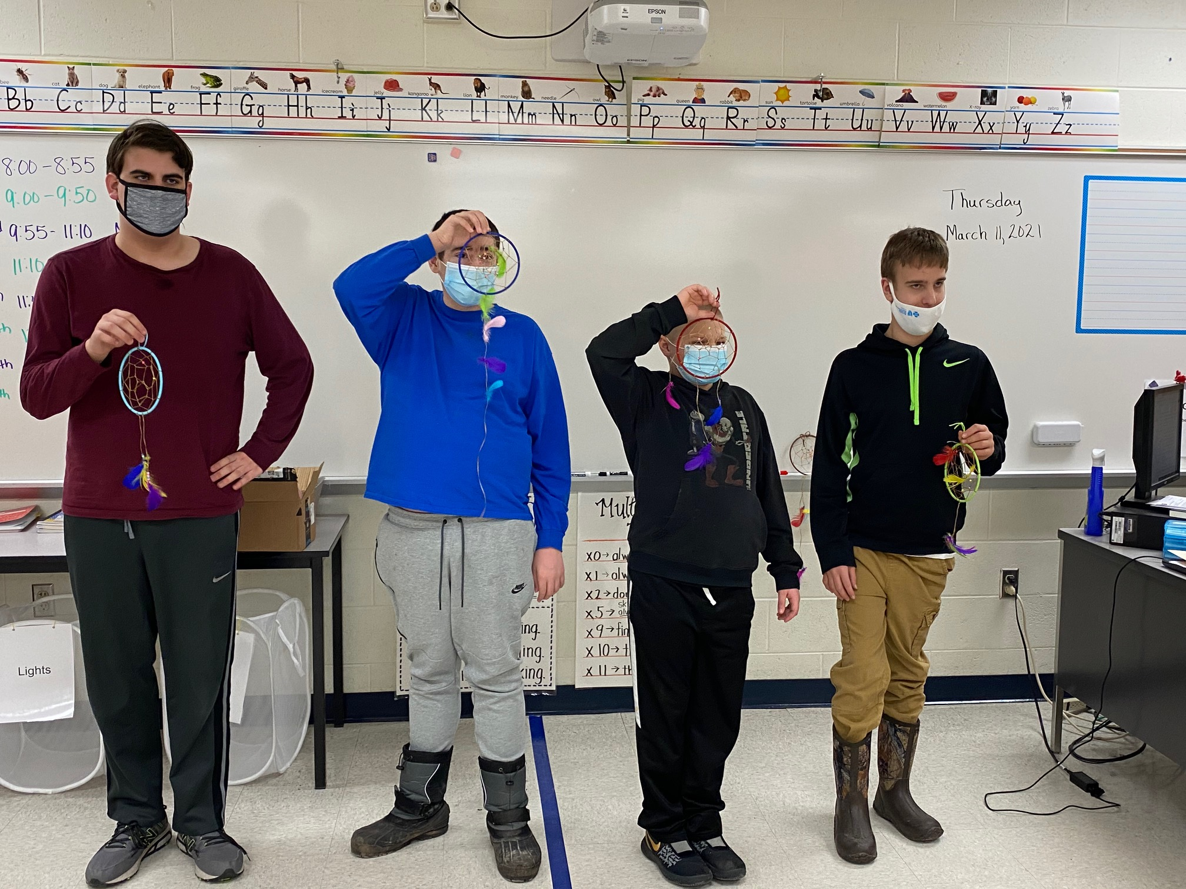
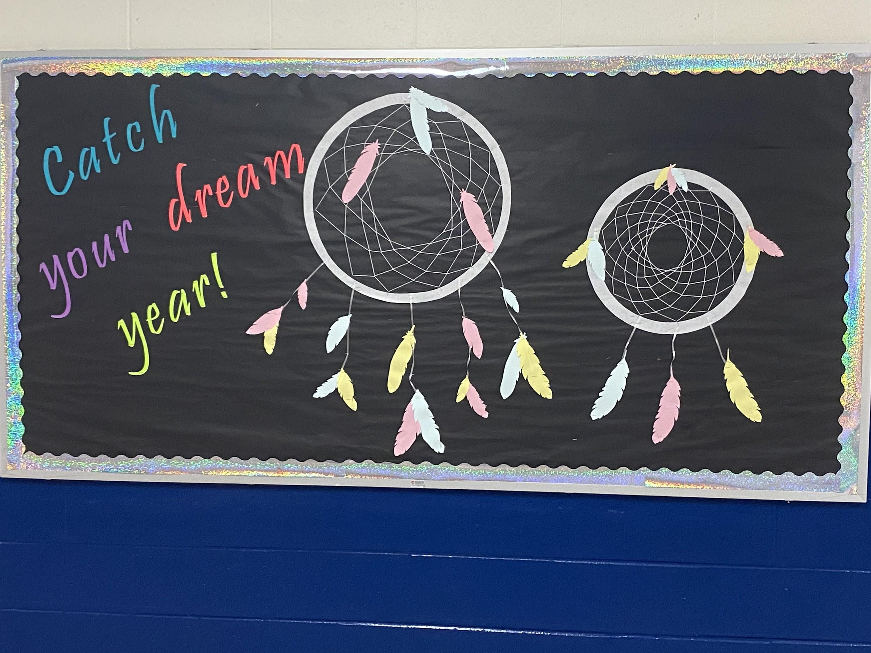
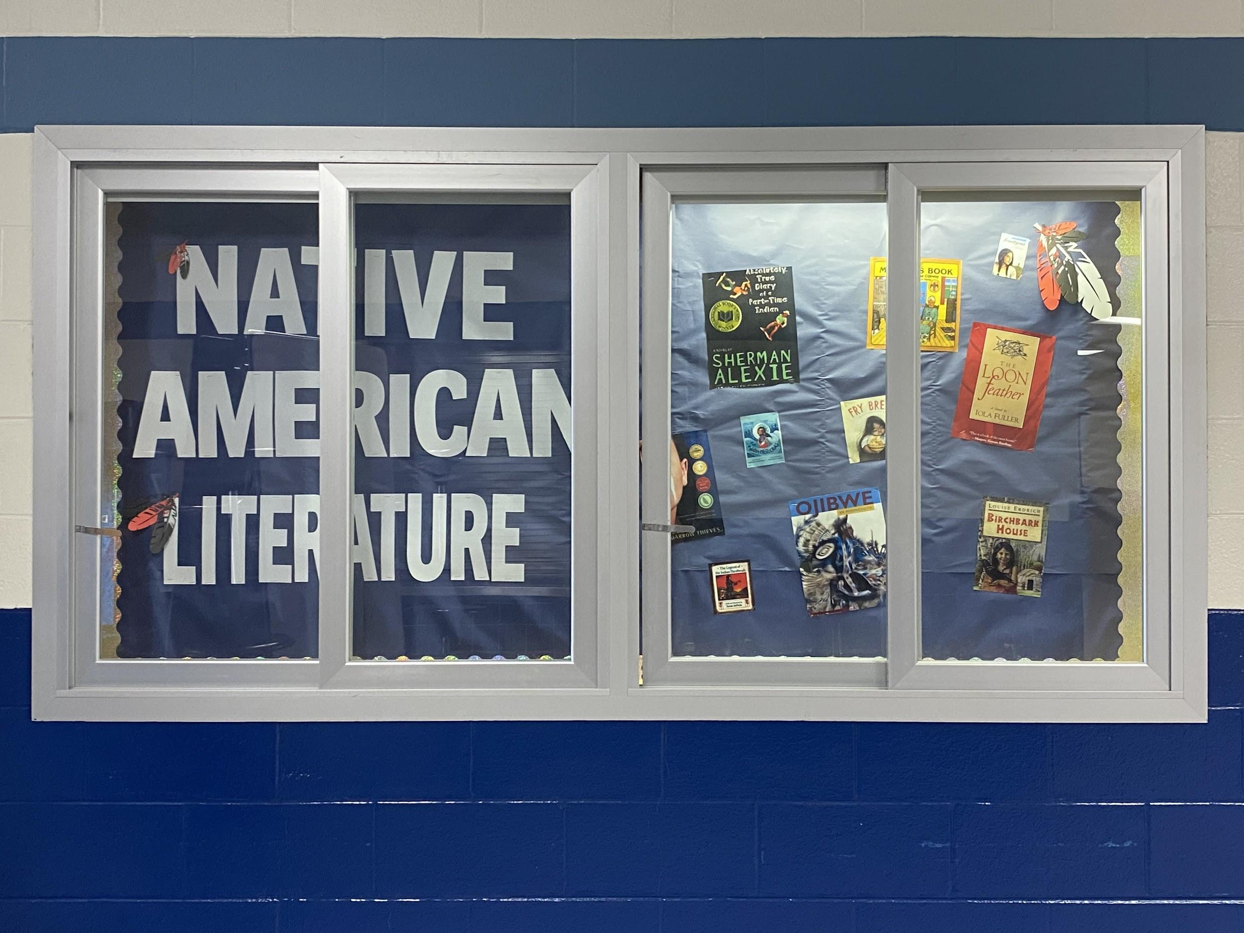
Picture Highlights from 2020-2021

Slide 27
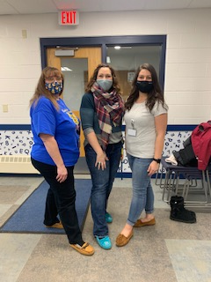
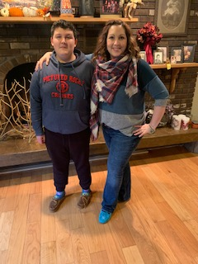
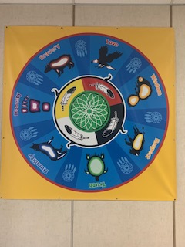
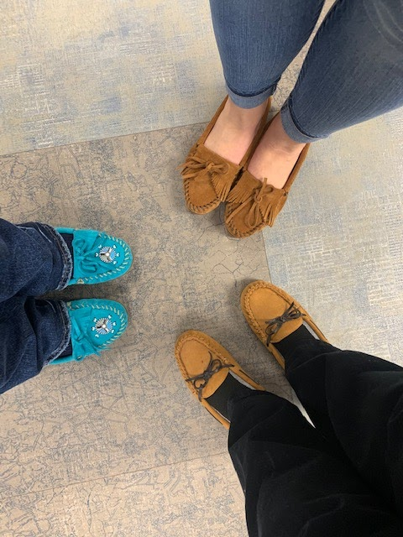
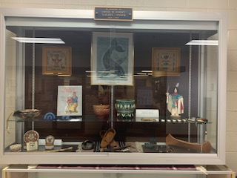
Picture Highlights from 2020-2021

Slide 28
QUESTIONS AND/OR COMMENTS

